Slide 1
DevOps on Azure
Senaj Lelic
Trainer
WW Education

Slide 2
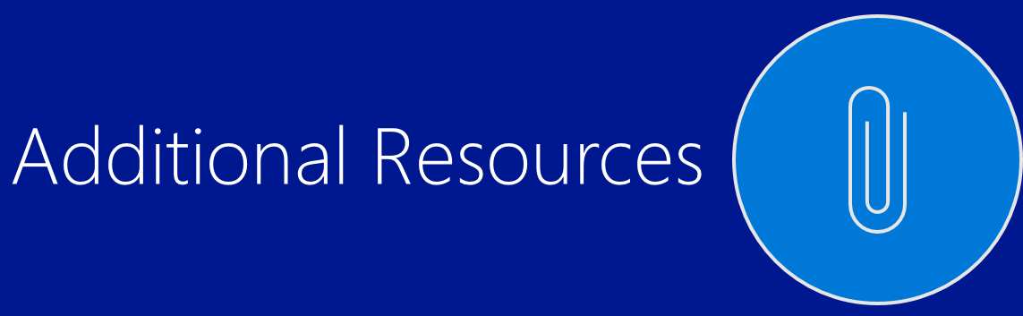
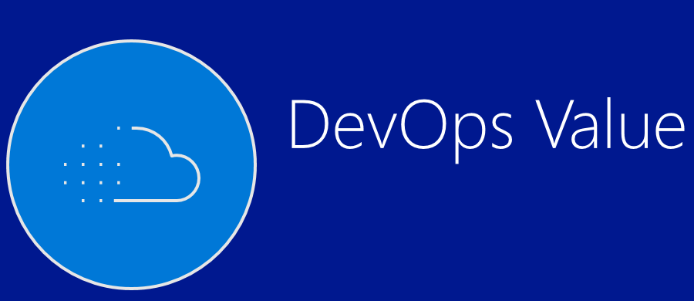
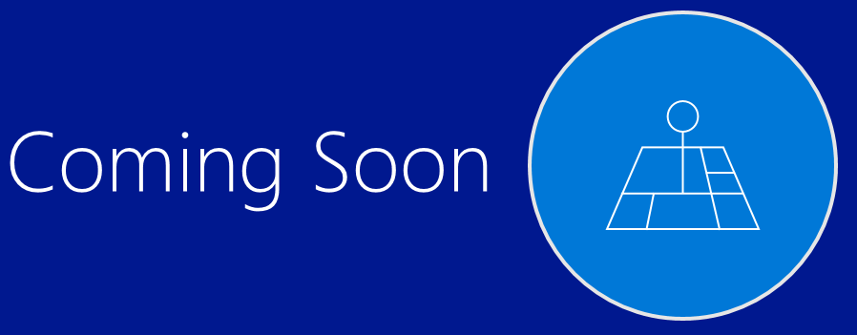
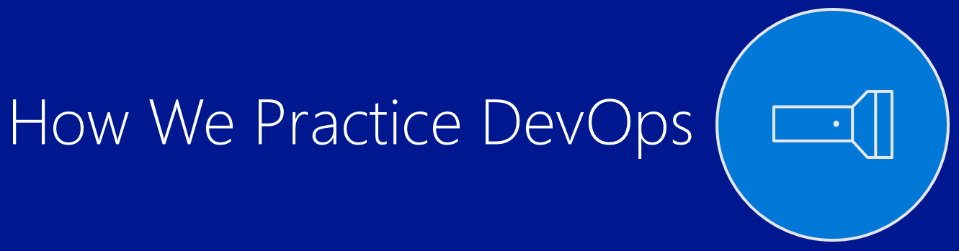

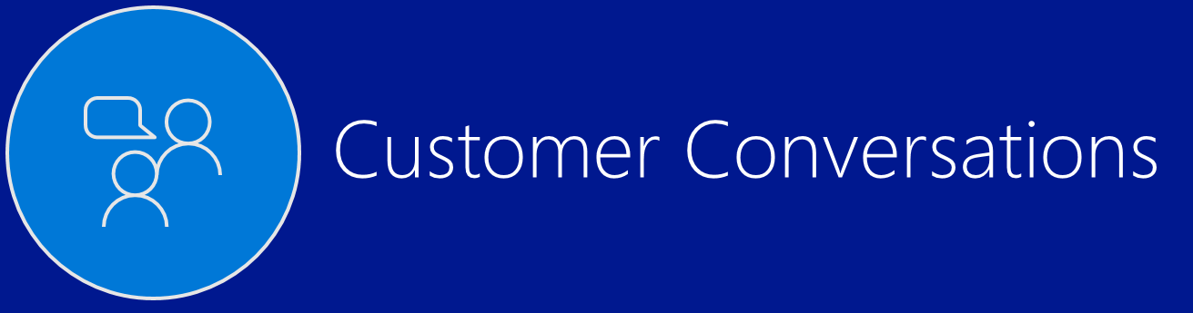
DevOps on Azure

Slide 3
DevOps Value
Notes:
DevOps story

Slide 4

What is DevOps?
DevOps is the union of people, process, and tools to enable continuous delivery of value to our customers.
Increase flow of value
Shorten cycle times
Continuously Improve
Notes:
Our definition of DevOps is the union of PEOPLE, PROCESS and TOOLS to enable the continuous delivery of value to our CUSTOMERS

Slide 5

Core and Context
Core
Differentiation that
wins customers
Context
Everything else
Core
Differentiation that wins customers
Context
Everything else
Mission Critical Failure=> Deep trouble
Mission Critical failure=> deep trouble
$$$
Risk
$$$
Risk
Enabling
Everything else
Enabling
Everything else
Innovate
Housekeeping
* http://ecorner.stanford.edu/videos/1327/Core-and-Context

Slide 6

Why DevOps Matters for Digital Transformation
Core
Context

Slide 7
Shift the Portfolio to Innovation and Go Fast
Core
Context
Invest in Innovation
Buy Infrastructure and SaaS Automate

Slide 8
The last 20 years…
Chasm of despair
Development
Operations
Develop
Test
Maintain
Build
Stabilize
Deploy
Support
Translate business requirements to code
Focus on completing feature work on time with quality
Focused on faults, uptime and isolated automation
Focus on reliability, compliance, and financial management
Intermediaries, strict control, and long lead times to deploy

Slide 9
The next 20 will be a period of alignment
Outcomes
Foundation
Reliable
Repeatable
Culture
Toolchain
Aspirational
Process
Platform

Slide 10
The Law of Thirds
Delivery cycle

Slide 11
The Law of Thirds
Delivery cycle
Delivery cycle
Delivery cycle
Delivery cycle
Delivery cycle
Delivery cycle

Slide 12
To maximize validated learning
Delivery cycle
Delivery cycle
Delivery cycle
Delivery cycle
Delivery cycle
Delivery cycle
Validated learning
Value of improvement
Deployment frequency

Slide 13
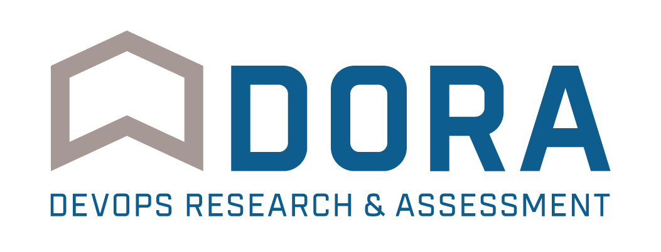
Outcomes vary widely by org performance
Survey questions | High IT performers | Medium IT performers | Low IT performers
Deployment frequency For the primary application or service you work on, how often does your organization deploy code? | On demand (multiple deploys per day) | Between once per week and once per month | Between once per week and once per month*
Lead time for changes For the primary application or service you work on, what is your lead time for changes (i.e. how long does it take to go from code commit to code successfully running in production? | Less than one hour | Between one week and one month | Between one week and one month*
Mean time to recover (MTTR) For the primary application or service you work on, how long does it generally take to restore service when a service incident occurs (e.g. unplanned outage, service impairment)? | Less than one hour | Less than one day | Between one day and one week
Change failure rate For the primary application or service you work on what percentage of changes results either in degraded service or subsequently requires remediation (e.g. leads to service impairment, service outage, requires a hotfix, rollback, fix forward, patch)? | 0-15% | 0-15% | 31-45%
* Note: Low performers were lower on average (at statistically significant level), but had the same median as the medium performers.
Notes:
Takeaway: High performers are maximizing throughput while maintaining the highest levels of stability. This means they are able to get new features and bug fixes to market faster, get customer feedback, and iterate more rapidly.
Low performers have increased their throughput, compared to 2016 results, and are deploy faster and more frequently, but they’re still doing poorly in terms of stability. We speculate that this is due to low-performing teams are optimizing for speed, but not investing enough in building quality into the process, which takes time.
The result is larger failures that take more time to restore service. High performers understand that they don’t have to trade speed for stability or vice versa, because by building quality in, they get both.

Slide 14

46x
More frequent
Code deployments
That’s the difference between multiple times per day and once a week or less.
440x
Faster lead time from commit to deploy
That’s the difference between less than an hour and more than a week.

Slide 15

96x
Faster mean time to recover from downtime
That means high performers recover in less than an hour instead of several days
5x
Less likely that changes will fail
That means high performers' changes fail 7.5% of the time instead of 38.5%.

Slide 16
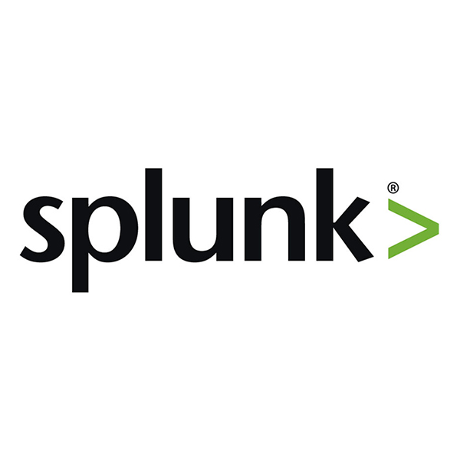


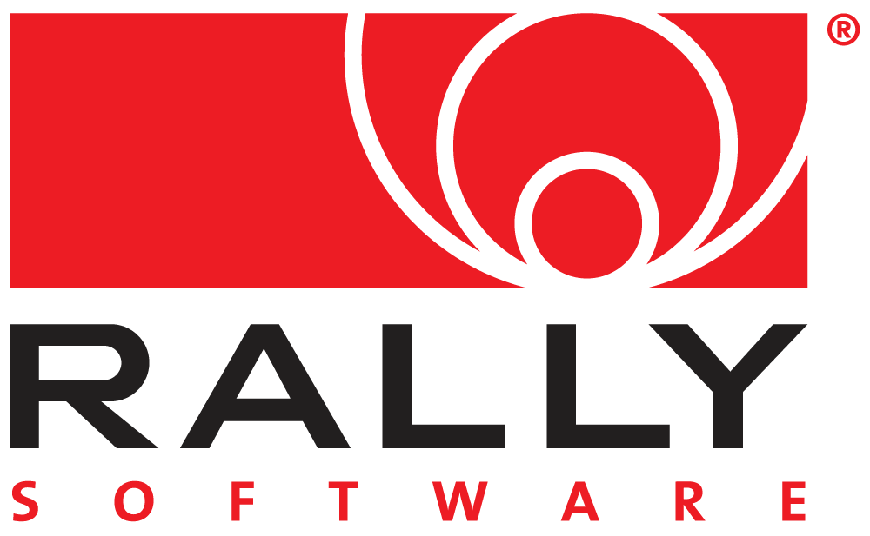
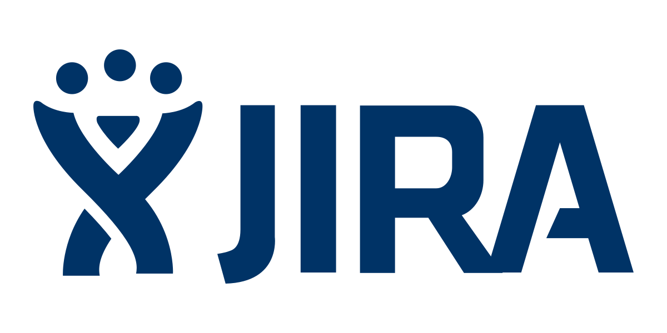
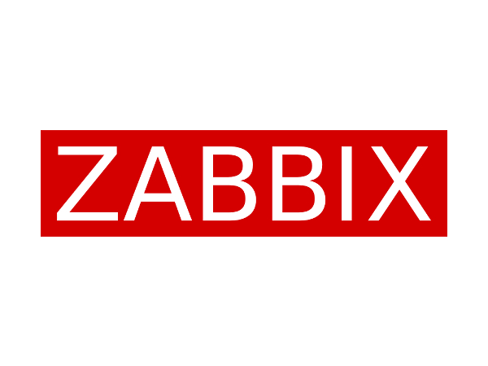
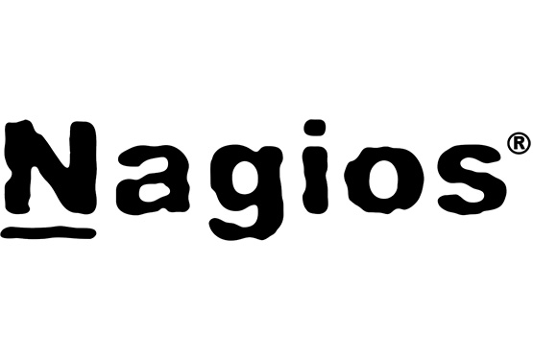
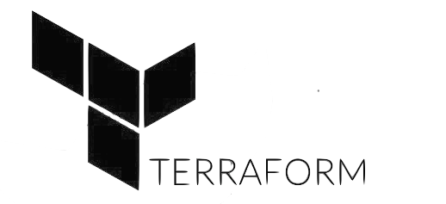


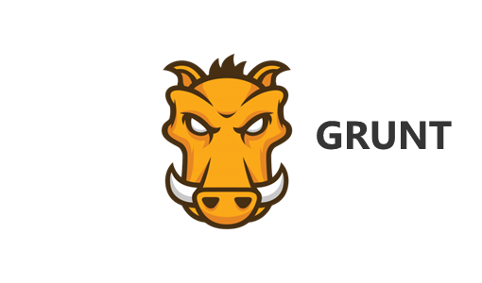
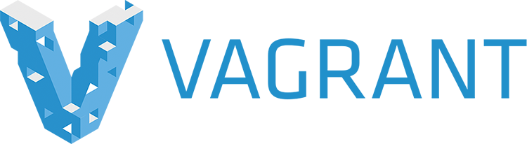

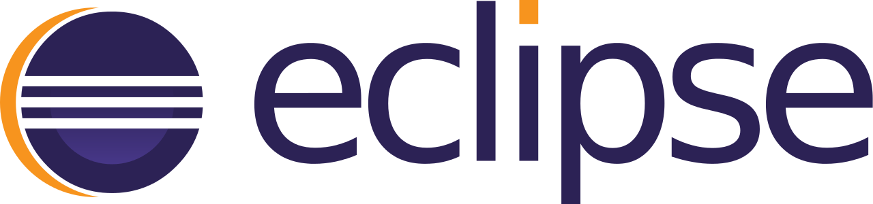
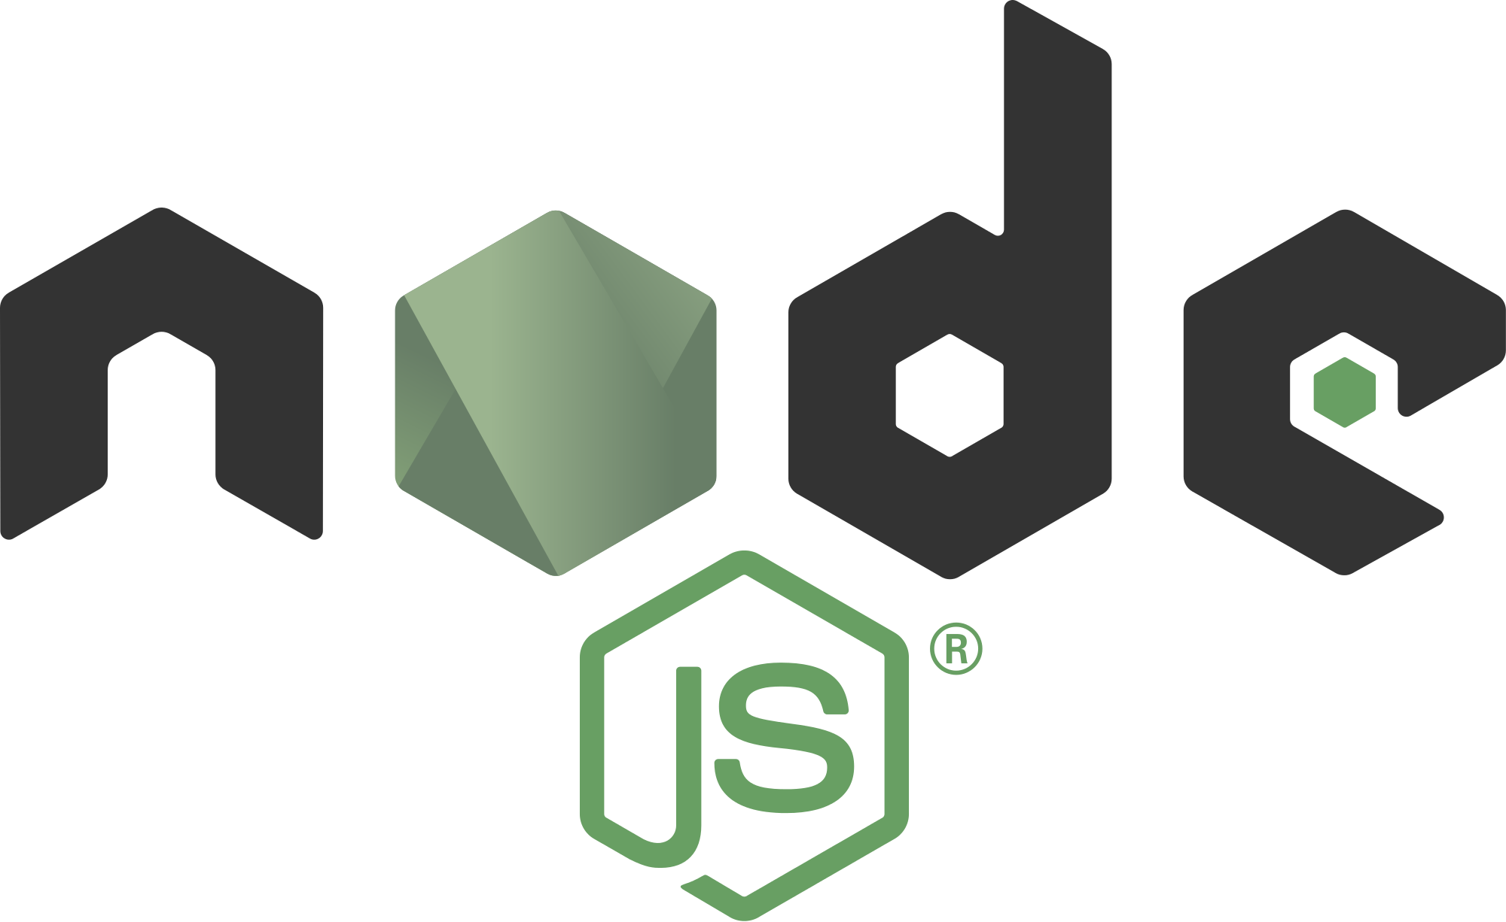

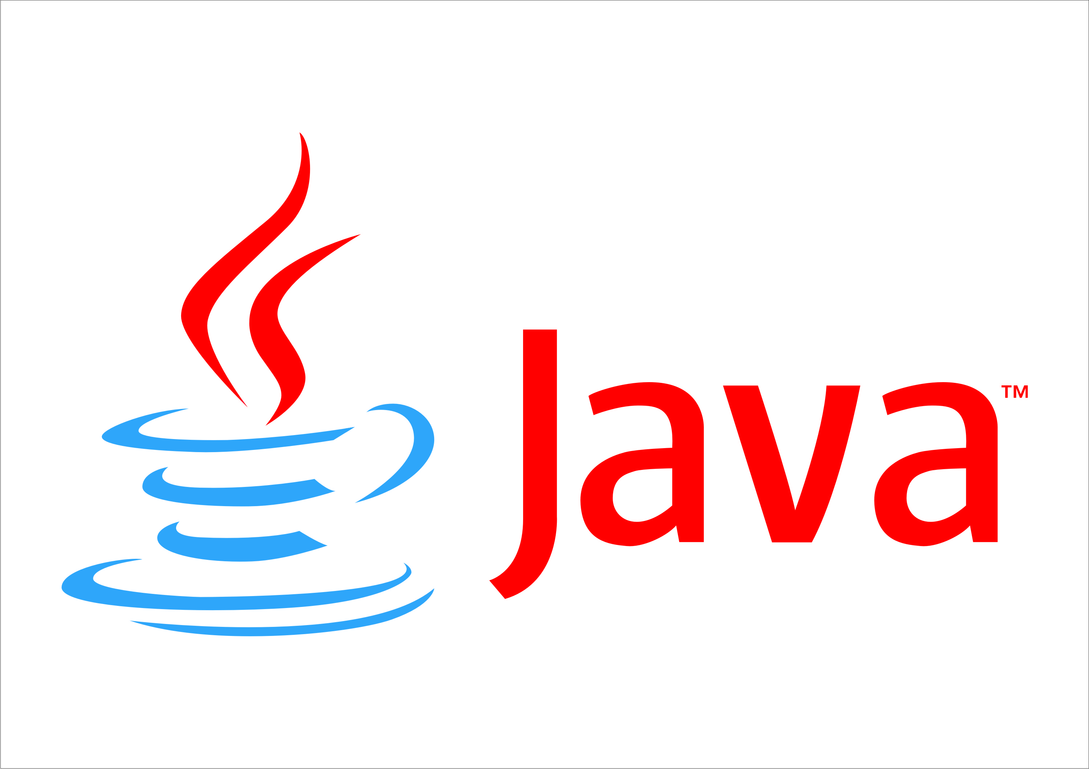
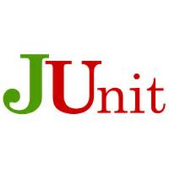
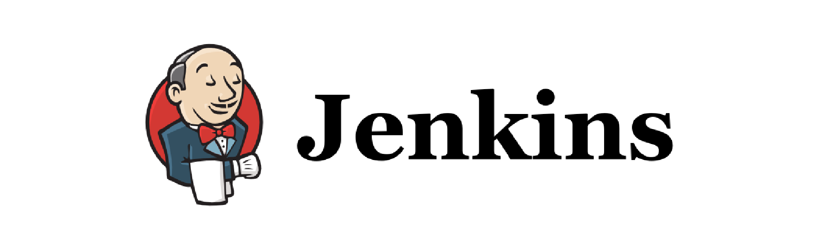
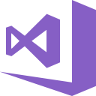
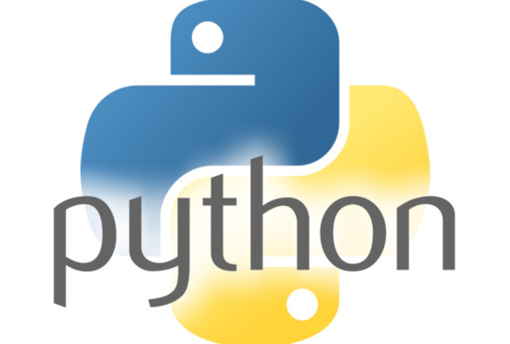
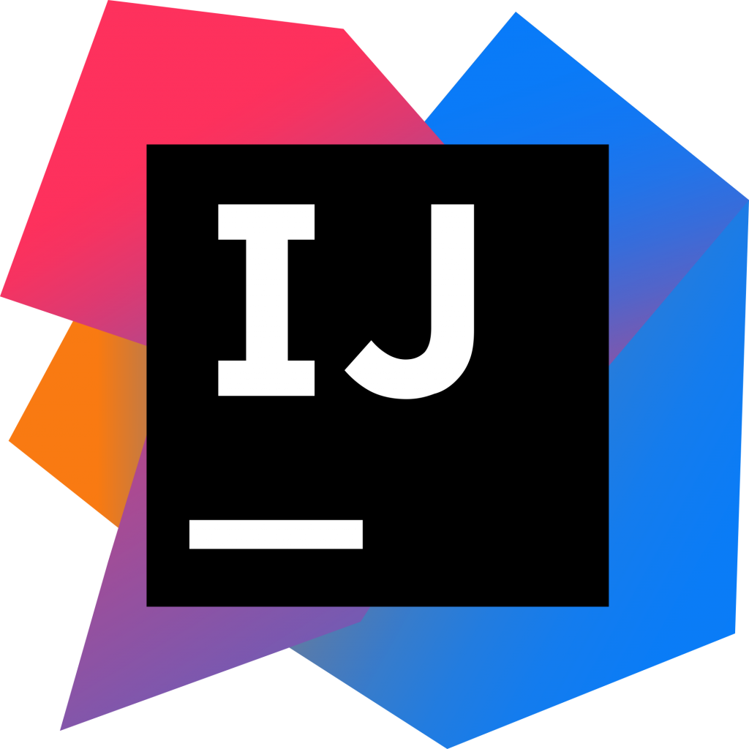
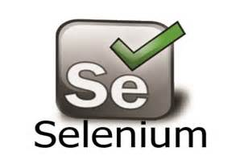
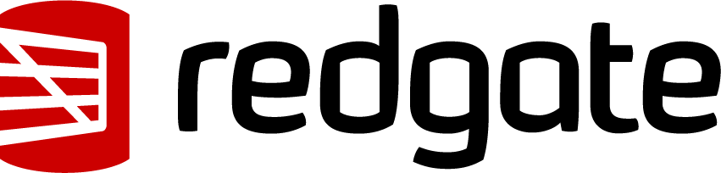

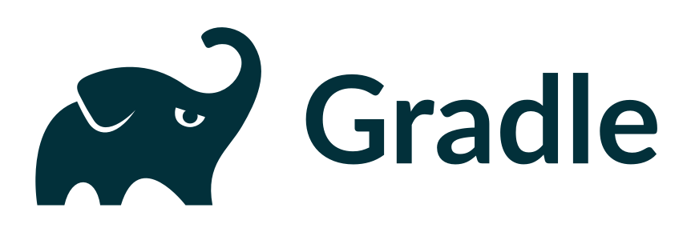
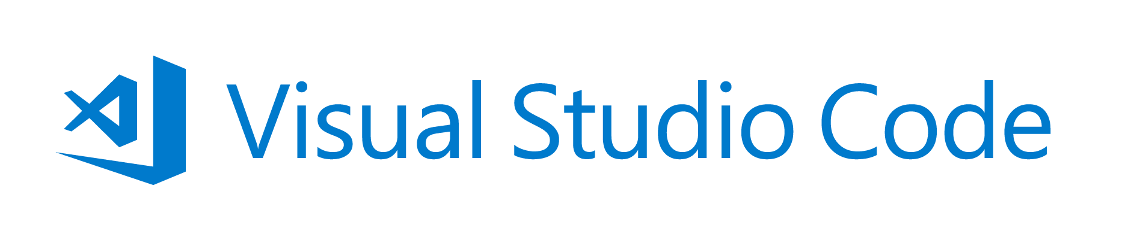
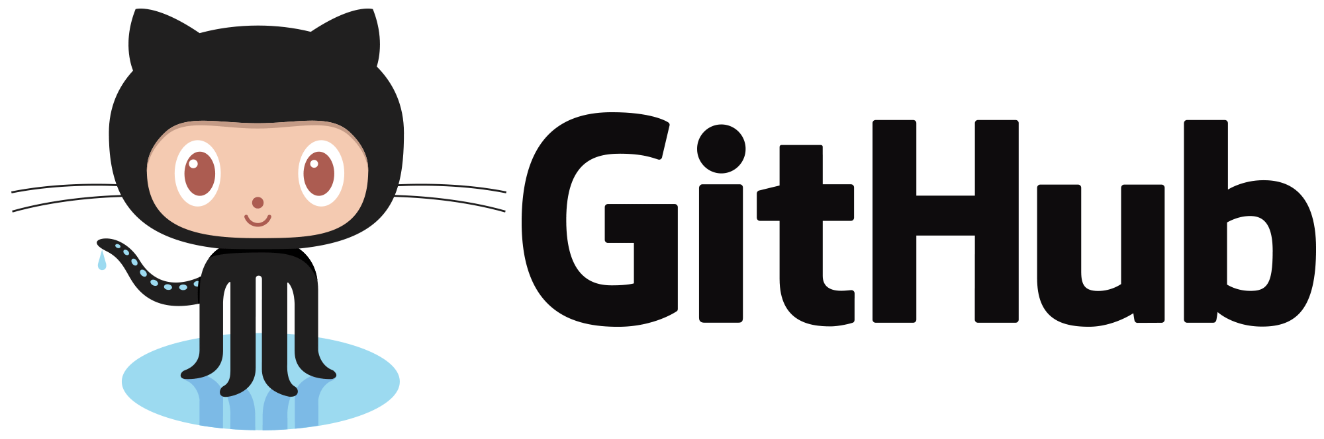

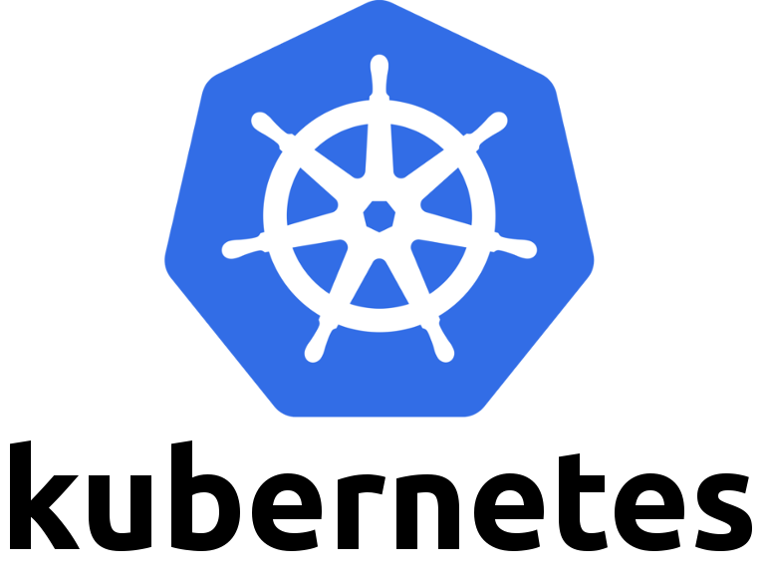
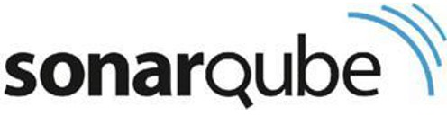
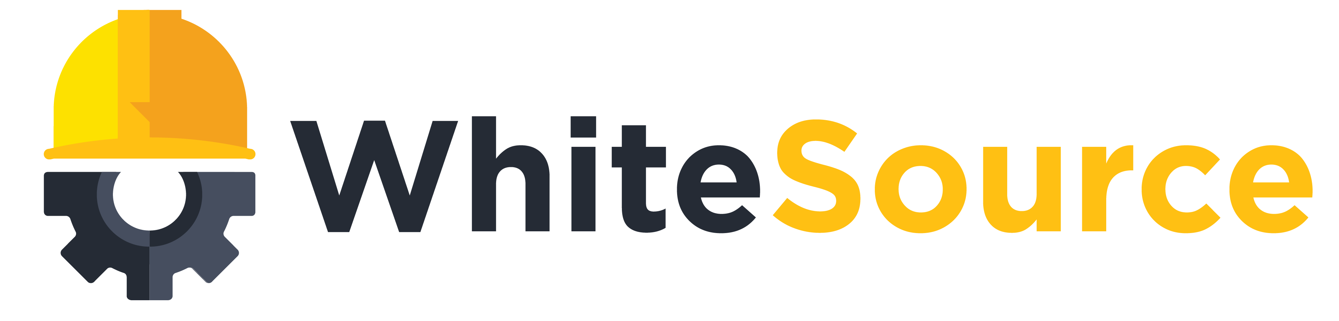
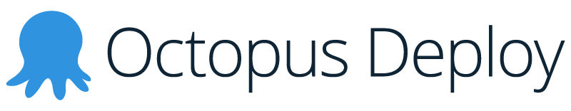
DevOps with Azure & VSTS
Monitor and learn
Feedback
Application Insights
Monitor
Automated functional testing environment
Pre-production environment
Track progress
Plan work
VSTS
Plan and track
Release
Manage work
Project starts
Integration testing environment
Staging environment
Write code
Visual Studio
Unit testing
Version control
Build
Build verification
Develop and test
Notes:
Objective:
Azure has you covered for all your container needs.
Key talking points:
Whether you’re running Linux or Windows Server containers, we have VM extensions to support running your Docker containers on those VMs.
Our own Service Fabric and other Microservice PaaS platforms that also support containers are available, including Pivotal Cloud Foundry and Red Hat OpenShift
The Azure Container Service provides a really fast way to get containers into production with a choice of popular open source container orchestration solutions: DC/OS or Docker Swarm
And we also have a rich and growing set of partner technologies in the Azure Marketplace including Docker, Mesosphere, Kubernetes and more.
Azure has all your container needs covered from development through to large scale production.

Slide 17
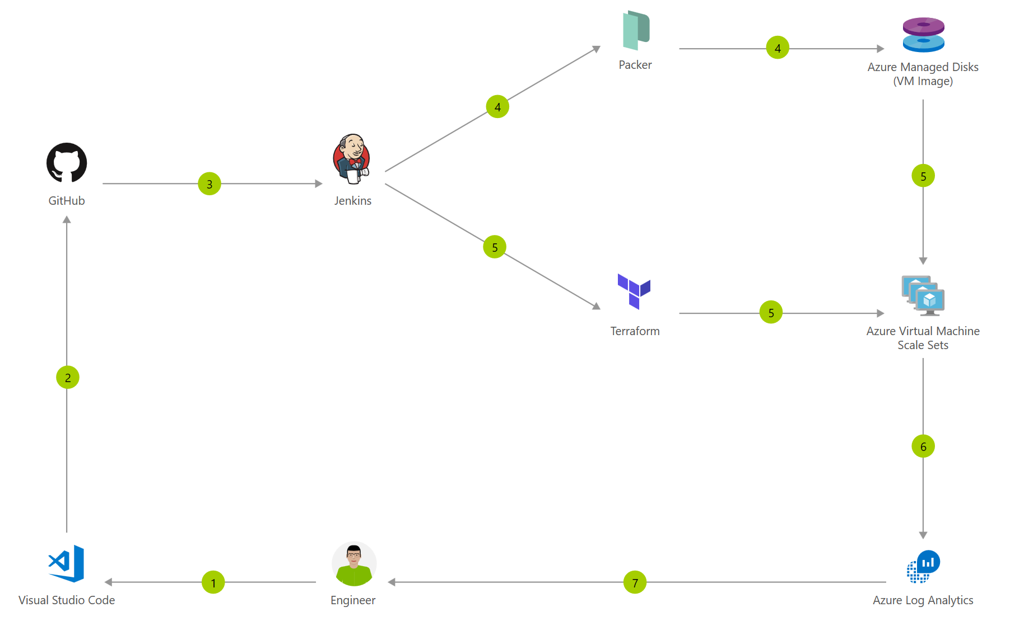
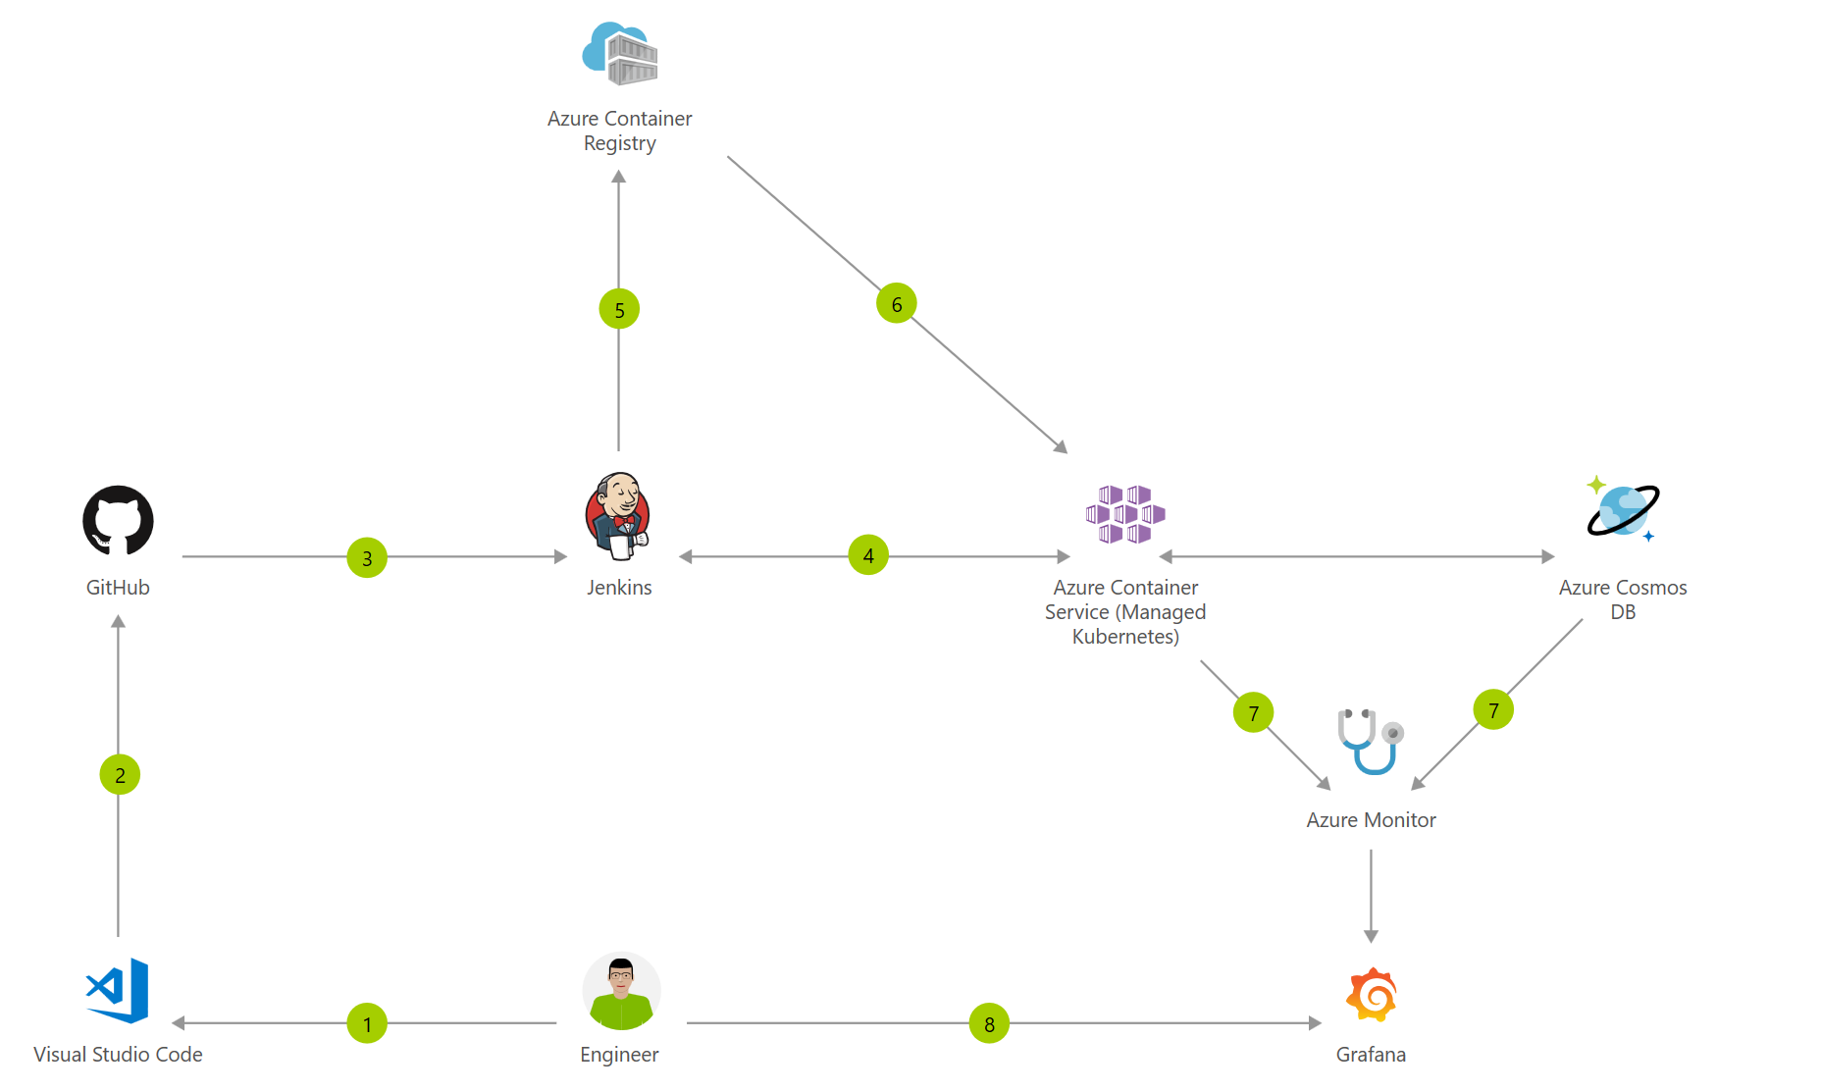
DevOps with Azure and Open Source Software
Azure, Jenkins, Terraform & VMSS
Azure, Jenkins, Containers & AKS
Notes:
Great Azure plays well with VSTS but my customer already or wants to use OSS tooling. That is just fine. We have great integrations with top OSS tooling.
Tooling enables and allows customers to progress from mutable as well as immutable
Allows customers to work with infra that they are comfortable with be it Virtual Machines, containers, functions …

Slide 18
Open Source
According to Forrester, over forty percent of CIOs view adoption of open source technologies as critical for them in the next year – primarily because of low cost, avoidance of vendor lock-in and agility.
And that same North Bridge study saw use of OSS increased sixty-five percent over same companies surveyed from previous year.
Mark Russinovich on Microsoft Blog
Notes:
Customers use and will continue to use OSS so we need to be where they are and meet them where they are going

Slide 19
Hybrid Cloud is here to stay!
Source: RightScale 2017 State of the Cloud Report
95% Customers are using Cloud
Customers running apps in 4 clouds on average
Experimenting in 4 more
22%
67%
5%
Public = 89%
Private = 72%

Slide 20
Azure Usage by Open Source Integrations
MICROSOFT CONFIDENTIAL
Notes:
- As we continue to invest in OSS integrations with Azure it enables and unblocks customer usage of azure
- Adoption of OSS integrations enables customers to use more Azure resources

Slide 21
Customer Conversations
Notes:
IFTTT VSTS as well as OSS

Slide 22
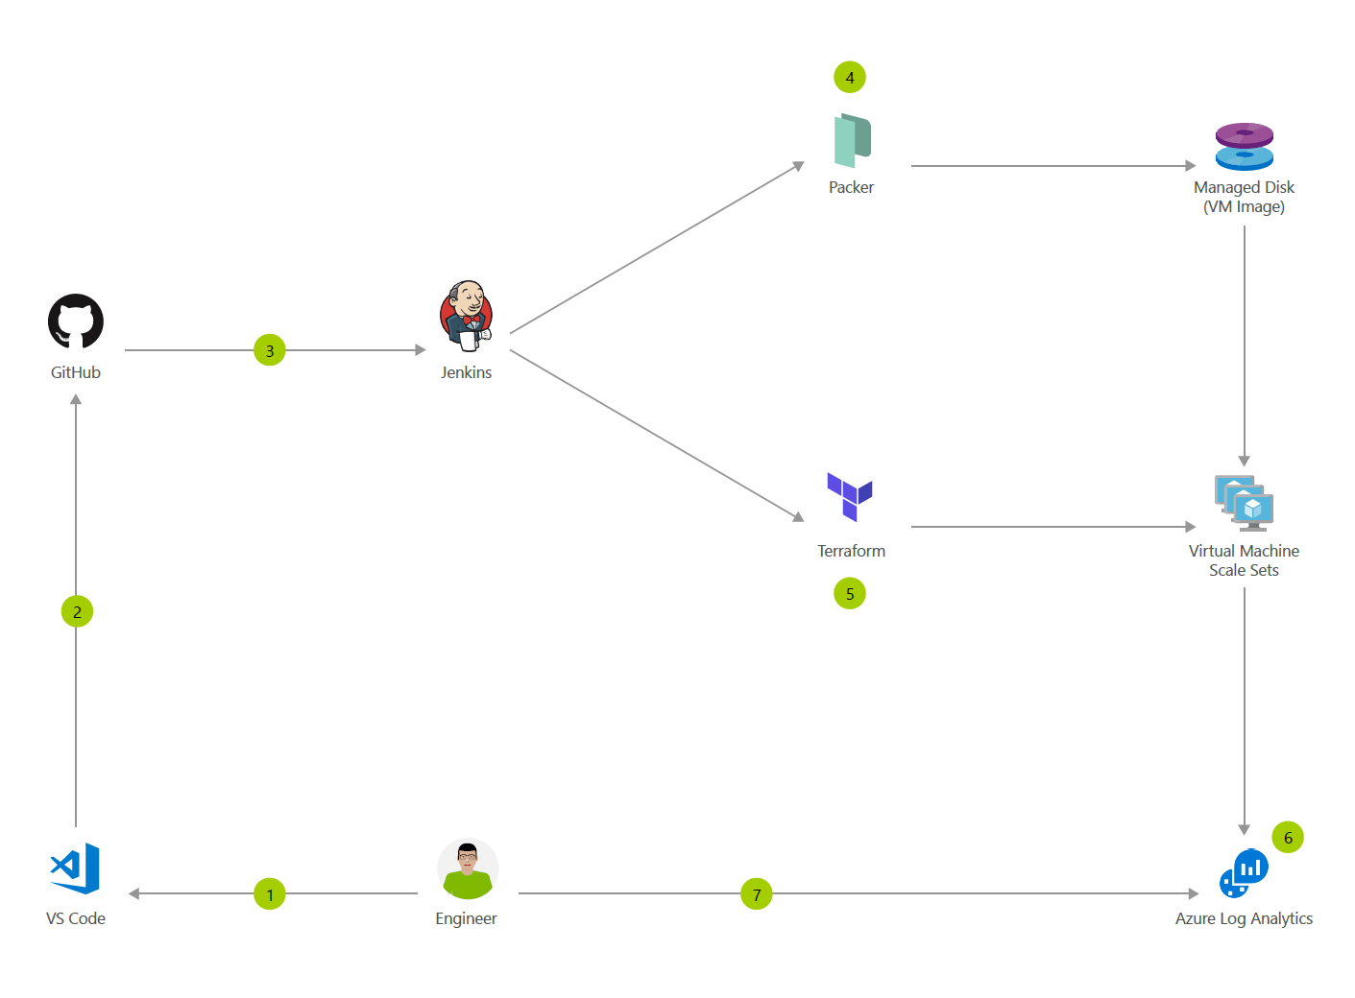

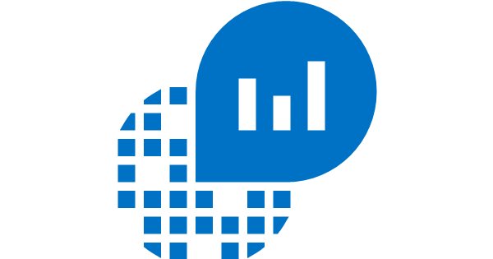



DevOps on Azure
+
….
VSTS as an
End-to-end DevOps Solution
Orchestrate your process with VSTS
Bring your toolchain to Azure
Application
Insights
Azure Monitor
Log Analytics
Azure Security Center
Notes:
Overarching DevOps story for customers: Whether they want:
VSTS full solution
BYO tools
VSTS + tools/process
They can deliver continuous innovation faster and more reliably with DevOps and Microsoft Azure
???Regardless of your choice you can take advantage of the reliable and integrated security, monitoring & management capabilities of the Azure platform – spend less time fighting fires and more time meeting business requirements

Slide 23

Customer conversations
Customer asks… | Your most likely card…. | Microsoftready.com sessions
We worry about our competitors and Digital Transformation, but don’t know how think about it | Experimentation mindset: get faster and measure | API-AZI202
Lift and Shift, now what | Use DevOps to innovate and add value *best practice* | CD-DEV222 This one CD-DEV201 Competitive bakeoff CD-DEV217
We hear about DevOps, but don’t know how to get started | Azure DevOps Projects…the new “File New” or Hello World
Use an OSS toolchain, want to try Azure | Here’s to use Jenkins (or Terraform/Docker/Kubernetes) with Azure and/or VSTS CD | CD-DEV-ILL301 CD-DEV-ILL302
We want to try this out before deploying to production | Start with implementing in Dev/Test environments
Looking for help with a specific pain point… | CI/CD, Git, Agile, Test, Monitoring, Log Analytics, Security | See references

Slide 24


Use and orchestrate your favorite 3rd party tools. Your toolchain, seamlessly integrated with Azure.
“Azure support for Docker, Kubernetes, Puppet, Terraform, Cassandra, and other open source tools has become very important to us and has really accelerated our move into Azure.” – Robert Rudduck, Director of Architecture and DevOps Read the story
Notes:
When we say open, we mean allowing you to use and orchestrate your favorite 3rd party tools and platforms. Your toolchain, seamlessly integrated with Azure.
Ambit energy is a great example of this…
Ambit Energy, of Dallas, Texas, is one of the leading retail providers of electricity and natural gas in the US, with approximately 1.5 million residential and commercial customers across 16 states and the District of Columbia.
Ambit Energy provides electricity and natural-gas services in deregulated markets around the world.
Ambit Energy leverage open source DevOps tools such as Terraform and Puppet, but utilized Visual Studio Team Services to orchestrate their entire CI/CD pipeline.
Allowing them to leverage their existing expertise in these technologies and supplement with additional capabilities of VSTS.
- Quote from Tom Phillips: Vice President of Data and Infrastructure “By using Azure, we stood up an infrastructure in Japan in two to three weeks. We couldn’t even have signed a hardware P.O. in that time if we were building our own datacenter.… We simply could not have gotten into the Japanese market without Azure.”

Slide 25
Demo
Mission Critical failure=> deep trouble
Azure DevOps Projects
Extending Zero to Hero
Enabling
Everything else
Notes:
Azure DevOps Projects

Slide 26
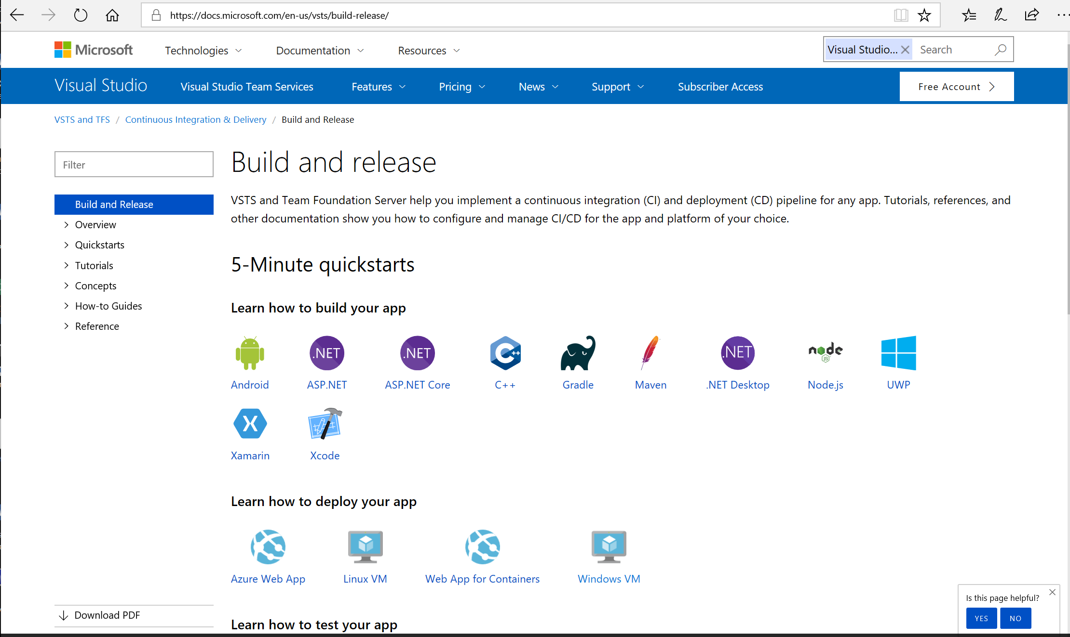

Slide 27
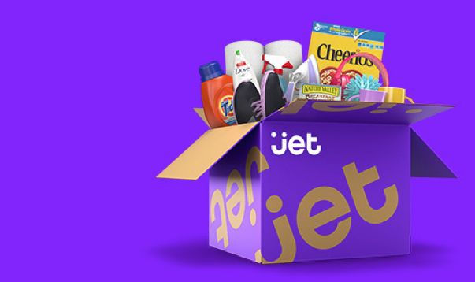
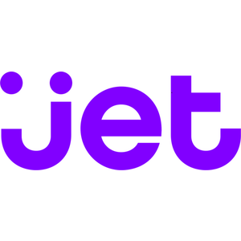
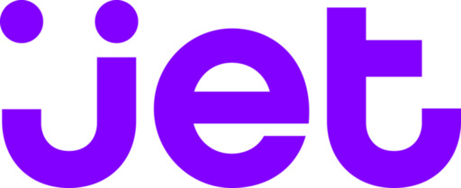
Spend less time building delivery pipelines and more time delivering software
E-commerce challenger eyes the top spot, simplifies development and delivery with DevOps on Azure “Being able to leverage so many off-the-shelf services and tools from Azure enabled us to go from zero to a full- fledged e-commerce marketplace in just about 12 months.” – Mike Hanrahan, CTO Read the story
Simple
“Being able to leverage so many off-the-shelf services and tools from Azure enabled us to go from zero to a full- fledged e-commerce marketplace in just about 12 months.” – Mike Hanrahan, CTO
Read the story
Notes:
When we say simple, we mean spending less time building delivery pipelines and more time delivering software.
Azure makes it simple to implement end-to-end DevOps solutions, as well as integrate you existing toolchains
A great example of that is Jet.com
Jet.com is an online marketplace that provides instant pricing reductions based on what’s in a customers shopping cart at any point in time
Jet.com was able to take advantage of Azure and Visual Studio to go from zero to a full-fledged e-commerce marketplace in just about 12 months

Slide 28

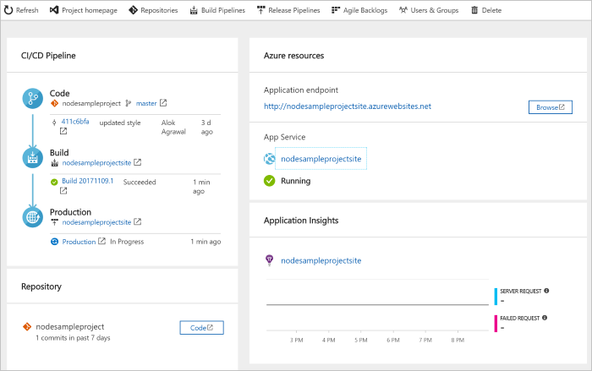
Get Started Quickly
Simple
Azure DevOps Projects
Create a full CI / CD pipeline with 3 easy steps from the Azure Portal
Start with a Git repo and any source language
Target any Azure service. Currently web apps, soon VMs, Kubernetes cluster and more.
Powered by VSTS - Customize, extend and scale when needed.

Slide 29
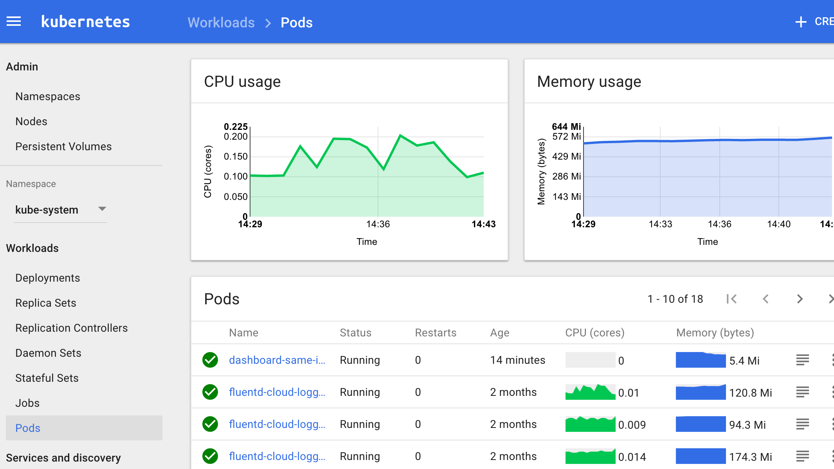
Managed Kubernetes
Simple
Simplified deployment, scaling, and operations
Quickly deploy a production ready Kubernetes cluster
Automated Kubernetes version upgrades and patching
Self-healing hosted control plane
Pay only for running agent pool nodes
Use all of the Kubernetes tools you like
Notes:
AKS reduces the complexity and operational overhead of managing a Kubernetes cluster by offloading much of that responsibility to Azure. As a hosted Kubernetes service, Azure handles critical tasks like health monitoring and maintenance for you. In addition, you pay only for the agent nodes within your clusters, not for the masters. As a managed Kubernetes service, AKS provides:
- Automated Kubernetes version upgrades and patching
- Easy cluster scaling
- Self-healing hosted control plane (masters)
Cost savings - pay only for running agent pool nodes
With Azure handling the management of the nodes in your AKS cluster, you no longer need to perform many tasks manually, like cluster upgrades. Because Azure handles these critical maintenance tasks for you, AKS does not provide direct access (such as with SSH) to the cluster.

Slide 30
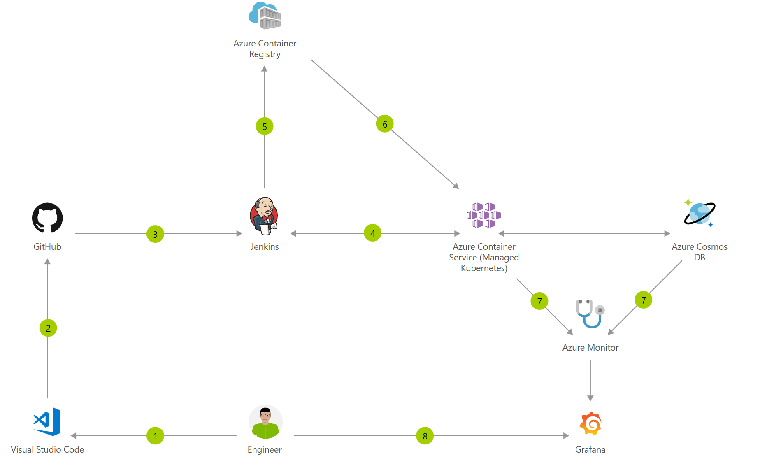
Demo
OSS pipeline to Azure Container Service
Mission Critical failure=> deep trouble
Enabling
Everything else
Notes:
Azure DevOps Projects

Slide 31


Deploy continuously and compliantly to enterprise-grade cloud services, with integrated security and monitoring.
“With DevOps and Azure, we’re able to reduce our new-feature release cycle down to one week, and we think we can even speed that up.” – Fikri Larguet, Director of Cloud Services
Read the story
Notes:
When we say reliable, we mean being able to deploy continuously and compliantly to enterprise-grade cloud services, with integrated security and monitoring
Geico is a great example of this…
Geico is a leading insurance provider with over 10,000 employees
Challenged by increased customer appetite for 24/7 digital engagement, Geico needed to deliver new services and features to customers faster.
Traditionally new feature rollouts to their tier 1 business systems often results in downtime that could be devastating to their online business
By adopting a DevOps development strategy and transitioning development to Microsoft Azure, GEICO is working to engage customers more personally and dynamically.
With the help of partner Applied Information Sciences, GEICO is moving to the cloud with a focus on increased efficiency, greater application availability, and lower costs.
Customer
Geico
Partner
AIS
Products and Services
Azure
Industry
Insurance
Organization Size
Corporate (10,000+ employees)
Country
United States
Downloads
GEICO Executive Slide : https://ms-f1-sites-01-cdn.azureedge.net/docs/stories/geico/resources/5c687a84-3286-443a-af16-877661876793/geico_executive_slide.pptx
More information (video, story)
https://customers.microsoft.com/en-us/story/geico

Slide 32
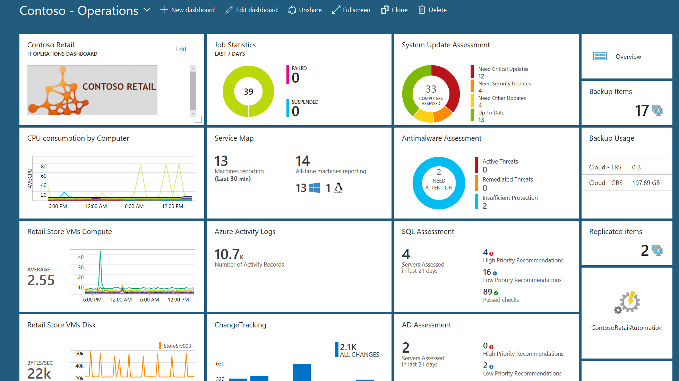
Monitor your cloud health
Reliable
Azure Application Insights, Monitor & Log Analytics
Collect and store your data from any source
Gain deep operational insights
Detect, diagnose, and fix issues quickly
Integrate to your existing processes & tools
Notes:
Monitor your cloud health with Log Analytics
Collect and store your data from any source
Easily collect, store, and analyze your systems and operational data from any source, both on-premises and in the cloud.
Collect data from a wide range of sources including virtual machines, storage accounts, activity logs, Windows, Linux Servers, Java, .NET, legacy and modern apps.
Centrally store activity logs, network logs, infrastructure metrics, app data points, diagnostics logs and alerts.
Gain deep operational insights
Understand CPU disk and memory utilization for your virtual machines.
Get a comprehensive view of applications and network dependencies across multiple virtual machines to perform root-cause analysis more quickly.
Track configuration changes, system updates, and malware status to improve security & compliance.
Visualize data in intuitive and customizable dashboards.
Find the information you need quickly using interactive queries and full-text search.
Detect, diagnose and fix issues quickly
Get notifications and alerts with rich diagnostic information so you can always stay on top of the issues.
Separate the signal from the noise and accelerate root-cause analysis across platforms using advanced analytics including machine learning algorithms.
Automate the implementation of recommended fixes so you can address issues quickly.
Integrate with customer service systems such as your ticketing tool to speed up implementation of fixes.

Slide 33
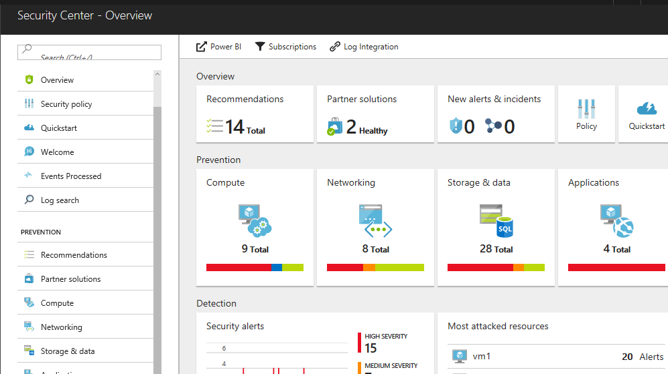
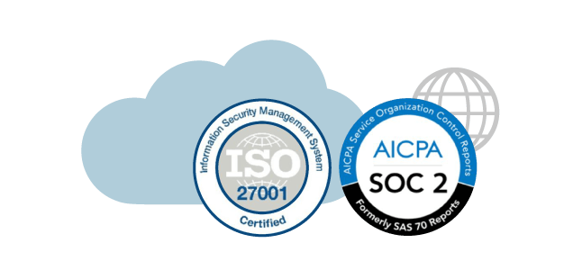
Secure your cloud resources
Reliable
Azure Security Center & Azure Policy
Gain full visibility and control of your cloud security state
Proactively identify and mitigate risks to reduce exposure to attacks
Quickly detect and respond to threats with advanced analytics
Notes:
Secure your cloud resources with Azure Security Center
With Azure Security Center you can gain full visibility and control of your cloud security state with a single, unified view:
Collect security data from multiple sources: Collect, search, and analyze security data from a variety of sources, including connected partner solutions like network firewalls and other Microsoft services.
Integration with existing security workflows: Access, integrate, and analyze security information using REST APIs to connect existing tools and processes.
Easily onboard cloud resources: Keep pace with rapidly changing cloud workloads. Automatically discover and onboard new resources created in your Azure subscriptions.
Continuous security assessment: monitor the security of virtual machines, networks, and Azure services using hundreds of built-in security assessments or create your own.
Built-in dashboards provide instant insights into security issues that require attention.
Centralized policy management: Ensure compliance with company or regulatory security requirements by centrally managing security policies across all your cloud workloads.
Compliance reporting: Use security data and insights to demonstrate compliance and easily generate evidence for auditors.
(If asked whether Azure Security Center supports hybrid workloads, the answer is yes: manage security across all your hybrid cloud workloads – on-premises, Azure, and other cloud platforms – in one console.)
You can also identify and mitigate risks proactively to reduce your exposure to security threats:
Proactive security assessment: Identify software and configurations that are vulnerable to attack.
Actionable recommendations: Remediate security vulnerabilities before they can be exploited by attackers with prioritized, actionable security recommendations and built-in automation playbooks.
Adaptive application controls: Block malware and other unwanted applications by applying whitelisting recommendations adapted to your specific workloads and powered by machine learning.
Controlled network access: Reduce the network attack surface with just-in-time, controlled access to management ports on Azure VMs, drastically reducing exposure to brute force and other network attacks.
Azure Security Center has robust capabilities to prevent attacks. When threats do happen, Security Center can quickly detect and respond to threats with advanced analytics and Microsoft Intelligent Security Graph.
Industry’s most extensive threat intelligence: Tap into the Microsoft Intelligent Security Graph, which uses trillions of signals from Microsoft services and systems around the globe to identify new and evolving threats.
Advanced threat detection: Use built-in behavioral analytics and machine learning to identify attacks and zero-day exploits. Monitor networks, machines, and cloud services for known attack patterns and post-breach activity.
Prioritized alerts and incidents: Focus on the most critical threats first with prioritized security alerts and incidents that map alerts of different types into a single attack campaign. Create your own custom security alerts as well.
Streamlined investigation: Quickly assess the scope and impact of an attack with a visual, interactive experience. Use predefined or ad hoc queries for deeper exploration of security data.
Contextual threat intelligence: Visualize the source of attacks on an interactive world map. Use built-in threat intelligence reports to gain valuable insight into the techniques and objectives of known malicious actors.

Slide 34
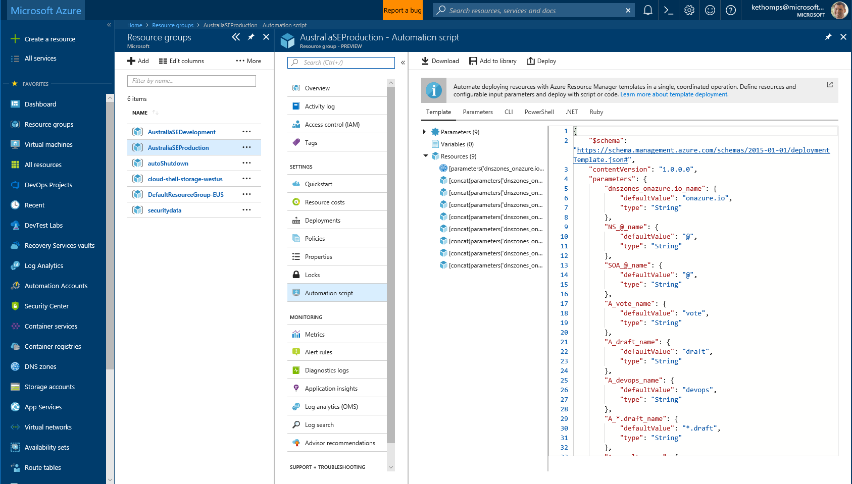
Deploy repeatedly & reliably
Reliable
Azure Resource Manager, Automation
& 3rd Party Integrations
Infrastructure as Code, built-in
Azure Config & Automation
Support for 3rd party and OSS tooling such as Terraform, Ansible, Chef & Puppet
Notes:
Deploy repeatedly & reliably using Infrastructure as Code
-sdfsdfsdf

Slide 35
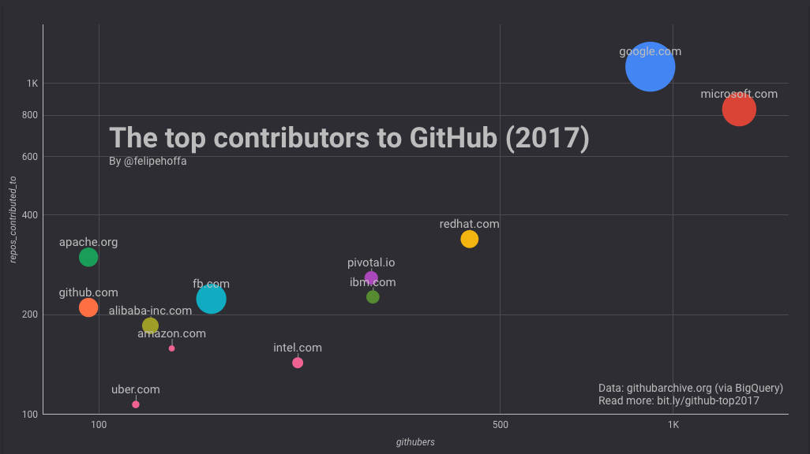
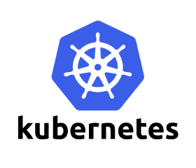

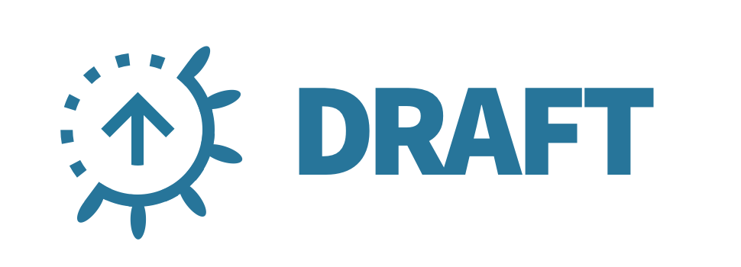
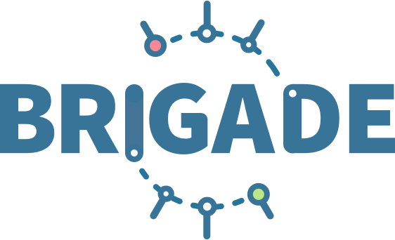


Microsoft Contributions
Open
Contributing to, and creating, Open Source projects for DevOps
Kubernetes & ecosystem
GVFS, Libgit2
Notes:
Microsoft has the highest number of open source contributors on GitHub of any organization in the world with 16, 419 contributors
Microsoft also makes one of the highest number of contributions to many repositories
Microsoft is the number three contributing organization to the Kubernetes project and we have created and contributed many projects in the Kubernetes ecosystem, including Helm and associated projects
Microsoft had a requirement for large filesystems when using Git for Windows SCM, so created the Git Virtual File System and made significant contributions to libgit2 which are now available for everyone to benefit from

Slide 36

Support for open source
Open
First class support for open source platforms
40%+ of VMs on Azure are Linux
Almost 60% of 3rd party IaaS offers in the Marketplace are OSS
Support for Docker across IaaS & PaaS
Native support for Java, Node.js, PHP, Python and more across many services
Notes:
Direct integration of popular OSS & 3rd Party tools such as Jenkins, Terraform and Ansible
Developer Hubs for projects provide clear guidance on how to both deploy these tools on Azure and also integrate them with Azure services, even if these run elsewhere
Canonical example shown here is http://docs.Microsoft.com/azure/Jenkins

Slide 37

Demo
Mission Critical failure=> deep trouble
OSS pipeline to Azure VMSS
Enabling
Everything else
Notes:
Azure DevOps Projects

Slide 38

DevOps Community
Tends to focus on the people as much as the technology
Very inclusive & strives for diversity
Primary Events: DevOpsDays, Velocity, DevOps Meetups
Influencing Companies: Netflix, Chef, Puppet

Slide 39
How We Practice DevOps
Notes:
VSTS DevOps processes & .Net Core processes

Slide 40

VSTS: Millions of Users + Most of Microsoft
Visual Studio Team Services
Company wide engaged users of VSTS in the Microsoft organization (Aug 2017)
Notes:
75,713 ACTIVE users in Aug 2017

Slide 41
Five habits of DevOps
Customer Focused
Production First Mindset
Team Autonomy + Enterprise Alignment
Shift Left Quality
Infrastructure as Flexible Resource
Notes:
Customer focussed, Team Autonomy and Shifting Left are basically second decade agile
DevOps brings Product First Mindset and Infrastructure as a Flexible Resource into play
Note that they all result in some inter-related processes. We’ve got to where we are now over a long time, and it’s been a very iterative process.
But we’re not done – we’ve still lots to learn.

Slide 42
Demo
Mission Critical failure=> deep trouble
How We Work
Enabling
Everything else
Notes:
VSTS & .Net Core

Slide 43
Getting Started
Notes:
Buying process for VSTS and Quickstarts for OSS

Slide 44
Buying VSTS
What you buy:
Pay per user for the features needed by each team member (Basic, Test Manger, Package Management, 3rd party features)
Pay per max CI/CD concurrency that your team needs (hosted pipelines, private pipelines)
Pay per use for cloud-based load test runs
How you buy:
Start in the Visual Studio Marketplace to define how much you want to buy
Set up billing using an Azure subscription (can pay via credit card, Enterprise Agreement, Cloud Solution Providers)
Monthly charges appear on your Azure bill
How much it costs:
Always use the Azure Pricing Calculator, which also shows pricing in local currency.
(There are lower promotional prices for EA customers currently, but these promo prices should be ignored for longer-term budgets)
What you don’t buy:
Storage, bandwidth, and hosting
Backup, disaster recovery, compliance
Software licenses
How you don’t buy:
You never submit Purchase Orders for a SKU; doing so will not turn on VSTS services for you
What you don’t pay for:
Visual Studio subscribers on your team get Basic features free (plus more for higher-level subscriptions)
5 other team members get Basic and Package Management features free
4hrs/month of CI/CD is free

Slide 45
Buying Process in VSTS
Marketplace URLs for buying:
VSTS users
CI/CD - hosted pipelines
CI/CD - private pipelines
Test Manager
Package Management
Customer sets up a new VSTS account
Customer buys more via the Visual Studio Marketplace
No credit card or Azure subscription required
Includes default free tier of service
Uses Azure Monetary Commitment for EA customers
Customer adds users to their team within VSTS Users hub
Select an Azure subscription for billing: Direct/PAYG, EA, CSP, Open, etc.—they all work
Counts as ACR
Ongoing charges are for the full month
Charges appear on monthly Azure bill
Can add users up to the free + paid limit, based on what they purchased
Charges are prorated during the 1st month

Slide 46


Slide 47

DevSecOps: Security embedded in DevOps
OSS Vulnerabilities
WhiteSource**
Container Security
Aqua**
Static Analysis Security Testing (SAST)
OWASP
SonarQube
AttackFlow
Brakeman
CPPCheck
LAPSE
.NET Security Guard
Coverity*
Parasoft**
VeraCode**
Fortify*
Checkmarx**
* - A commercial brand covering related security products
** - A company selling a security products
This Photo by Unknown Author is licensed under CC BY-SA
Notes:
References
https://samate.nist.gov/index.php/Source_Code_Security_Analyzers.html
https://www.owasp.org/index.php/Source_Code_Analysis_Tools

Slide 48



Developer Hub for Azure
http://aka.ms/tfhub
https://docs.microsoft.com/azure/Terraform/
The best place to direct customers for technical guidance for Jenkins on Azure
Jenkins and Ansible Developer Hubs also launched
Notes:
So how do you get started contributing yourself? For this a word from our sponsor – as in Ken from Marketing.
Our hub has a bunch of content, the best way you can start is to test this and contribute to fix any content.

Slide 49

Azure DevOps Solutions site
Center for all Azure DevOps content
Find Customer Stories and partners specializing in DevOps
Take DevOps self-assessment

Slide 50



Azure DevOps Solution Architectures
3rd Party and Open Source Integrations
Clear guidance and example architectures for popular 3rd party tools, including Jenkins and Terraform
Azure Quickstart templates **Coming soon
Easily scale from POC to Production with Red Hat OpenShift & Pivotal Cloud Foundry

Slide 51
Thank you !

